Slide 1
Advances in Technology: How can we Assess the Potential, and then Confirm the Reality
Alfonso Iorio, MD, PhD Health Information Research Unit & Hemophilia Program McMaster University Canada
Notes:
(May 12 2014 4:15PM – 20 minutes)

Slide 2
Disclosure for Alfonso Iorio
In compliance with COI policy, EAHAD requires the following disclosures to the session audience:
Shareholder | No relevant conflicts of interest to declare
Grant / Research Support | Baxter (Bayer, Biogen Idec, Novo Nordisk, Pfizer – No conflicts)
Consultant | Bayer (Novo Nordisk – No conflicts)
Employee | CHESS/CHR/CHARMS, WFH Data & Demographics Committee
Paid Instructor | No relevant conflicts of interest to declare
Speaker bureau | No relevant conflicts of interest to declare
Honoraria | Bayer, Baxter, Biogen Idec, CSL, Novo Nordisk, Octapharma, Pfizer – No conflicts
Presentation includes discussion of the following off-label use of a drug or medical device: <N/A>

Slide 3
Haemophilia product development
HIV screening
rFIX available
Low-purity pd concentrates
High-purity concentrates
Cryoprecipitate
Intermediate-purity concentrates
rFVIII available
Manufacturing changes for rFVIII product
Mid
1960s
1970s
Early
1980s
Mid
1980s
Late
1980s
Early
1990s
Late
1990s
Early
2000s
Late
2000s
Today
Viral inactivation through heat treatment
HCV screening
Viral partitioning via chromatography steps
Nanofiltration
Modified concentrates
Donor/plasma screening for HBV
Heat-treated concentrates widely available
Solvent/ detergent available
Adapted with permission from Key NS, et al. 1. Key NS, et al. Lancet. 2007;370:439–448.
Notes:
3
3
From the subsitution paradigm to the true therapeutics concept
Surveillance was introcuced with the infections and safer concentrates, and it is even more needed with engeneeres model

Slide 4
A more realistic representation…
Haemophilia treatment progress
progress
effort
progress
effort

Slide 5
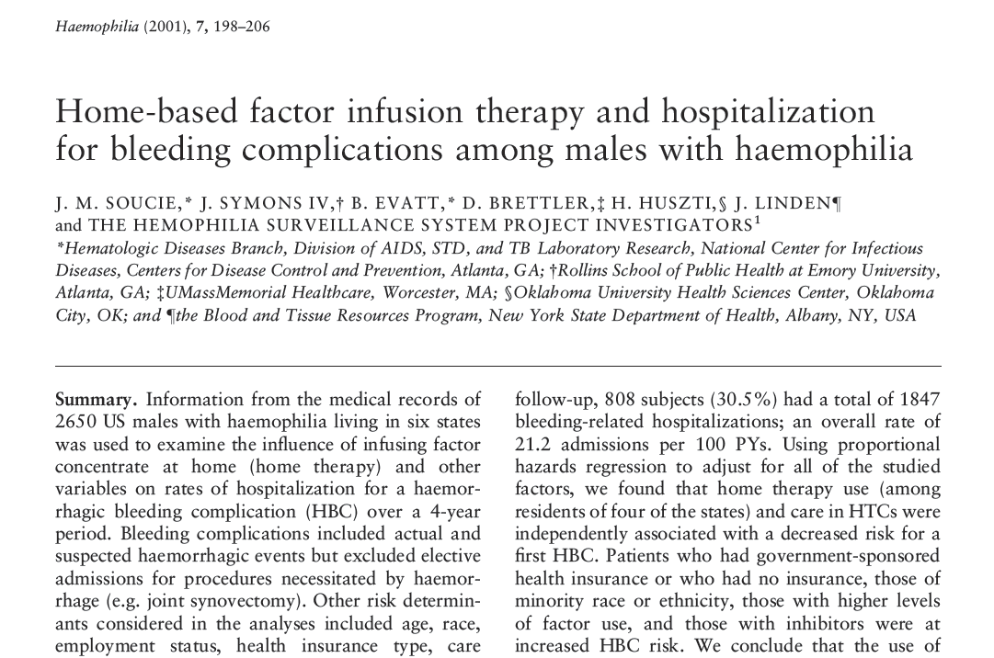

Slide 6
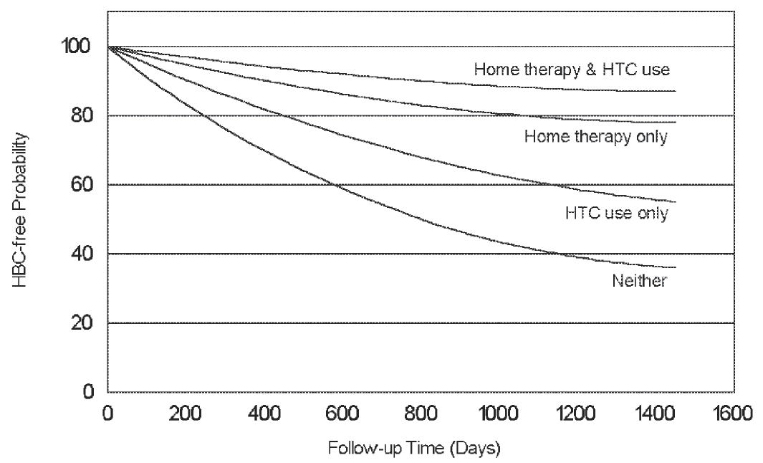

Slide 8
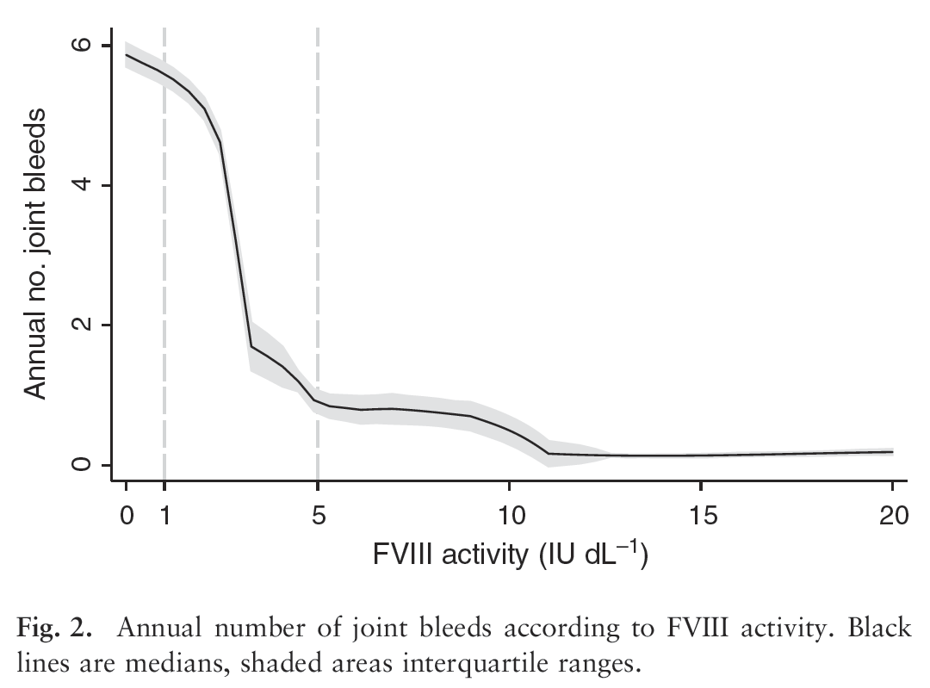

Slide 9
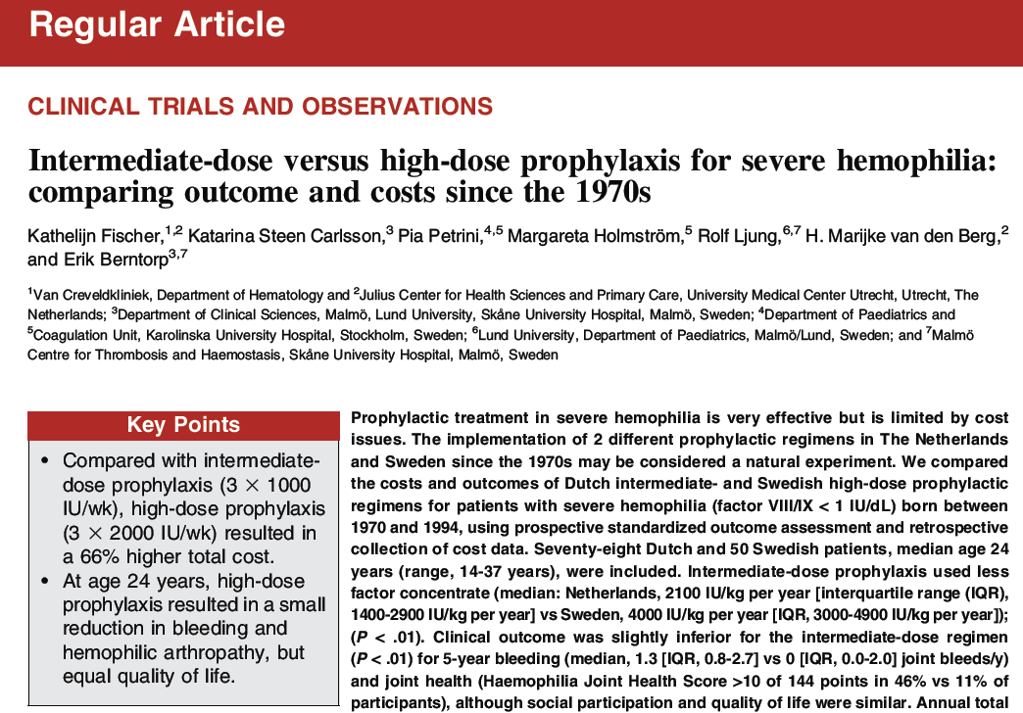

Slide 10
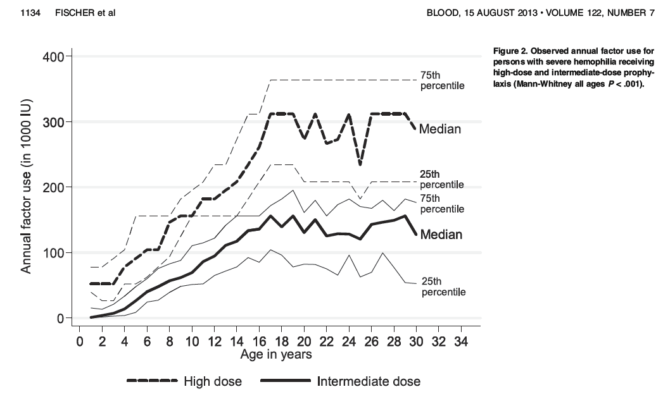

Slide 11
Long-term comparison of different regimens
 | Netherlands Median (IQR) | Sweden Median (IQR) | P
Joint bleeds, 5 yr | 10 (4–18) | 2.5 (0.-9.3) | <.01
Nr joints | 2 (1–4) | 3 (2–3) | .47
HJHS (max144) | 9.0 (2.0–18.) | 4.0 (2.0–6.0) | <.01
Activity (max 100) | 93 (81–98) | 99 (93–100) | <.01
EQ-D5 utility | 0.94 (0.81–1.00) | 1.00 (0.81–1.00) | .93
Factor cost | 851 (647–1048) | 1474 (1154–1778) | <.01
Lost production | 0 (0–0) | 0 (0–0) | .82
Fischer, K et al. Blood 2013;122(7):1129–36.
Notes:
Cost are cost x 5 years per patients in 1000 dollars.
Annual consumption u/kg 2100 (1400-2900) vs 4000 (3000-4900)

Slide 12
Study | Design | Main result | Key to interpret | Contribution
RODIN | P, R, MC | Year: 2000–2010 Tot: 340 (574) RC, RD: 28.2, 9.0% | Post hoc | Hypothesis generation
FranceCoag | P, CR, SC | Year: 2000–2010 Tot: 234 (303) RC, RD: 30.0, 15.0% | Strong “center” effect RODIN effect?? | Generate a second alternative hypothesis
UKHCDO | P, CC, SC | Year: 2000–2010 Tot: 300 (407) RC, RD: 23.8, 11.3% | Time effect, Refacto, RODIN effect | Generate alternative hypothesis
Vezina | S, R, SC | Y:2005–2010 Tot:86 (99) RC, RD: 36.0, 6.0% | Higher rate with Advate | You cannot “export” results?
EUHASS | P,DC, MC | Y:2009–2013 Tot:284 (417) RC, RD: 26.2, 4.5% | RODIN effect | Non-confirmatory
EAHAD IPD | IPD MA | Y:1994–2003 Tot: 80 (761) RC, RD:40.0, 6.6% | Any of the previous | Non confirmatory Direction of effect Inconsistency of results
Notes:
RODIN: you comment on the different objective of the study upfront; the non inclusion of the significant variable in the blood analysis
Advate: 42/172 24.4
Kogenate: 45/128 35.2
Refacto: 15/44 34%
RODIN (33/88 (37.5%) vs 85/319 (26.7%), P=0.05.
Advate nR 29/114
Advate R 13/48
Kogenate nR 35/107
Kogenate R 10/21
There was a trend for the incidence of low titre inhibitors to increase and for high titre inhibitors to decrease with time. Between 2000 and 2006, there were 25 low titre inhibitors in 205 PUPs (12.2%) compared with 33/202 (16.3%) during 2007-2013 (P=0.23). In 2000-2006 there were 37/205 high titre inhibitors (18.1%) compared with 23/202 (11.4%) in 2007-2013, (P=0.06).

Slide 13
Erik Berntorp, Alfonso Iorio. Blood, accepted
Kreuz W, Gill JC, Rothchild C, et al. Thromb Haem 2005;93:457–467.
Notes:
Split in three slides to interrogate point by point
alfonso

Slide 14
Kogenate
Advate
RODIN dashed
Advate 3/12 | 26/117 | 13/43
Kogenate 24/65 | 16/31 | 5/32
Notes:
Also comment that many patients when to Refacto, and got inhibitors
Solid line represent non-RODIN centers
For
Refacto AF significant effect on all (15/44, 34% -- 1.95 UNI 2.63 multi) – on HR (3/44 --- 0.87 1.28)
Refacto no effect on all (12/52, 23%) , non sign 1.7 – 1.5 for HR 10/52 19%

Slide 15
 | EUHASS |  |  | EUHASS -RODIN
 | P | 95% CI |  | P | 95% CI
Plasma D | 0.22 | 0.11 | 0.35 | 0.21 | 0.10 | 0.37
Recomb | 0.26 | 0.22 | 0.31 | 0.24 | 0.19 | 0.29
Advate | 0.26 | 0.19 | 0.34 | 0.26 | 0.18 | 0.36
Helixate | 0.32 | 0.18 | 0.50 | 0.33 | 0.18 | 0.52
Kogenate | 0.30 | 0.22 | 0.40 | 0.22 | 0.13 | 0.34
Refacto | 0.29 | 0.17 | 0.43 | 0.27 | 0.15 | 0.43
P: Proportion.

Slide 16
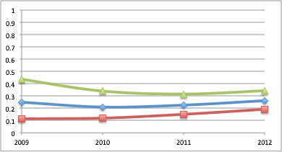
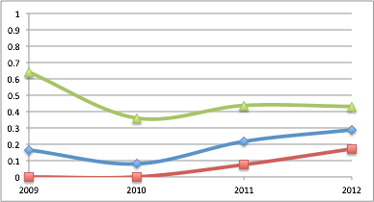
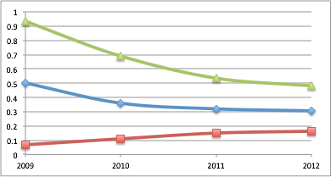
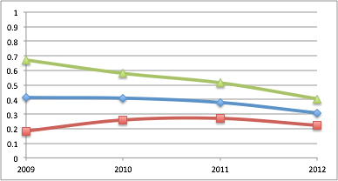
Year | 2009 | 2010 | 2011 | 2012
Inhib | 8 | 34 | 63 | 96
Exposed | 59 | 121 | 221 | 336
Proportion | 0.31 | 0.28 | 0.29 | 0.29
Data from the EUHASS annual reports to the Investigators
Notes:
The overall rate did not change - the figure is slightly different from the one of the final analysis, because this are non validated data. Data for individual studies converged. This suggests cancelling of random errors in the initial estimates. Also, it looks like PUPs are not so bad to this scope..

Slide 20
Risk of inhibitor development related to switching
Year | Lead Author | Design | Sample | Follow up months | Inhibitor | Rate pts/yr | Notes
1988 | Giles et al. | Prospective | 478 | 12 | 18 | 0.019
 |  |  | 339 | 24 | 17 | 0.030
2007 | Singleton et al. | Retrospective | 94 | ≤20 | 4 | 0.042 | All patients
 |  |  | 77 | ≤20 | 1 | 0.013 | (-) history
2007 | Gouw et al. | Retrospective | 316 | (>50 ED) | NR
2008 | Rubinger | Prospective | 225 | 12 | 0 | 0
 |  |  | 189 | 24 | 0 | 0
2009 | Rea et al. | Retrospective | 33 | >3 | 1 | 0.033
2011 | Siegmund et al. | Retrospective # | 118 | N/A | 0
2011 | Bacon et al. | Retrospective | 113 | Up to > 100 ED | 1 | 0.009
2014 | Hay | Retrospective | 1198 | 12 | Sw: 4/518 | 0.079
 |  |  |  |  | NS: 1/682 | 0.015
Iorio A, et al. Blood 2012;120(4):720–727. N/A: Not available; NR: Not reported; ED: Exposure day.
Notes:
BDD indicates B-domain deleted; ED, exposure day; NR, not reported; PTP, previously treated patients; and NA, not available.
*Rate of inhibitor positivity before switch was 0.079. When these patients were not excluded, rates were 0.038 at 12 months and 0.050 at 24 months.
†A total of 17 patients had history of previous inhibitors, of which 3 of developed a recurrence. All 4 inhibitors were transient, the only 1 de novo was secondary to surgery. At
study completion, 51 patients had 100 ED, and 24 had 20-100 ED.
‡The study enrolled PTPs and reported the RR for inhibitor development in 54 patients switching versus those not switching. The adjusted RR was 0.9 (95% confidence
interval 0.5-1.6).
§A total of 274 patients were tested at baseline, of which 4 were positive (0.014).
∏Cases observed over 8 years and switched from full-length to BDD factor VIII, the observed inhibitor was transient and secondary to surgery.
¶The cases were observed over 14 years, and switched from plasma-derived to recombinant factor VIII. A total of 101 patients had severe disease.
#The observed inhibitor was in a PTP. No recurrent inhibitors were observed after switching 16 patients with a positive inhibitor history.
Giles AR. Transfusion science. 1998;19:139-48.
Singleton E. Thromb Haemost. 2007;98:1188-92.
Gouw SC Blood. 2007;109:4693-7.
Rubinger M Haemophilia. 2008;14:281-6.
Rea C Haemophilia. 2009;15:1237-42.
Siegmund B. Hämostaseologie. 2010;30 S1:S37-9.
Bacon CL Haemophilia. 2011;17:407-11.

Slide 21
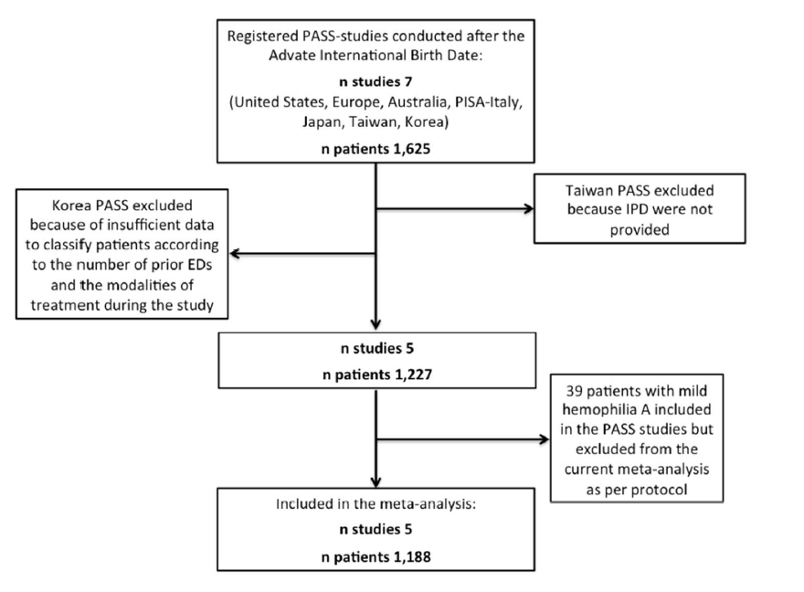
Patient data meta-analysis of Post Authorization Safety Surveillance (PASS) studies of hemophilia A patients treated with rAHF-PFM
Study |  | Patients (n 1,188)
Australia-PASS Europe-PASS Japan-PASS Italy-PASS US-PASS |  | 34 (2.9) 419 (35.3) 361 (30.4) 281 (23.6) 93 (7.8)
Iorio A, et al. Haemophilia 2014;20:777–783.

Slide 22
Patient characteristics and ABR
Characteristics, n (%) | Num (%) | ABR
>150 previous EDs | 1016 (85.5)
Prophylaxis at enrolment | 743 (62.6)
≥ twice/week during the study | 587 (49.4)
Characteristics, n (%) | Num | Median (Q1, Q3)
All patients | 1,140 | 3.83 (0.60, 12.90)
On demand at enrolment | 421 | 10.38 (2.27, 27.29)
On prophylaxis (on study, any frequency) | 710 | 2.00 (0, 6.73)
On prophylaxis (on study, ≥twice/week) | 557 | 1.66 (0, 4.78)
Median dose per infusion of 27 IU/kg (Q1 20, Q3 34)
ABR: Annualised bleeding rate.
Notes:
median dose per infusion of 27 IU/kg (Q1 20, Q3 34).

Slide 23
Effectiveness outcomes
Cure (as a synonym for normal life)
Healthy functional joints
Bleeding (annualised bleeding rate)
HJHS/Petterson/US/MRI
Pain
Working capability
School attendance

Slide 24
Safety outcomes
Inhibitor event rate in PTPs – so what?
As a result of our search, we identified:
39 de novo inhibitors reported in 19 publications + 26 EUHASS
Individual patient data has been collected for:
29 (74%) inhibitor cases overall
14 (36%) from CRFs completed by study investigators
15 (39%) extracted from patient-level information available in the published reports
Notes:
ISTH SSC project on harmonization of reporting of inhibitors in PTPs

Slide 25
Interim results: Inhibitor characteristics
Characteristic (n = 29) | Estimate
Age at inhibitor diagnosis (years) | ?
Peak titre level (BU/ml) | ??
Last know titre level (BU/ml) | ???
Patient follow-up (mo) | ????
Barbara A. Care until Cure grant competition, Canadian Hemophilia Society.
Notes:
Age: 2-67
Peak 0.5 – 75
Last titre 0-10.4
Follow up 1-143

Slide 26
Conclusions
Clear value of surveillance
Clear evidence for progress
Need for harmonisation
Need for more efficient tools for patient-reported outcomes

Slide 27
Thanks
Thank you!
You can download these slides at:
http://hemophilia.mcmaster.ca

